Slide 1


CODENAME :
COGSWORTH
Robert Cucchiara & Dave Dacosta

Slide 2
Initial Idea
Android Application
Super Talkative Alarm Clock App
Speech Functionality
Audible Alarm Notifications
Possible Machine Learning

Slide 3
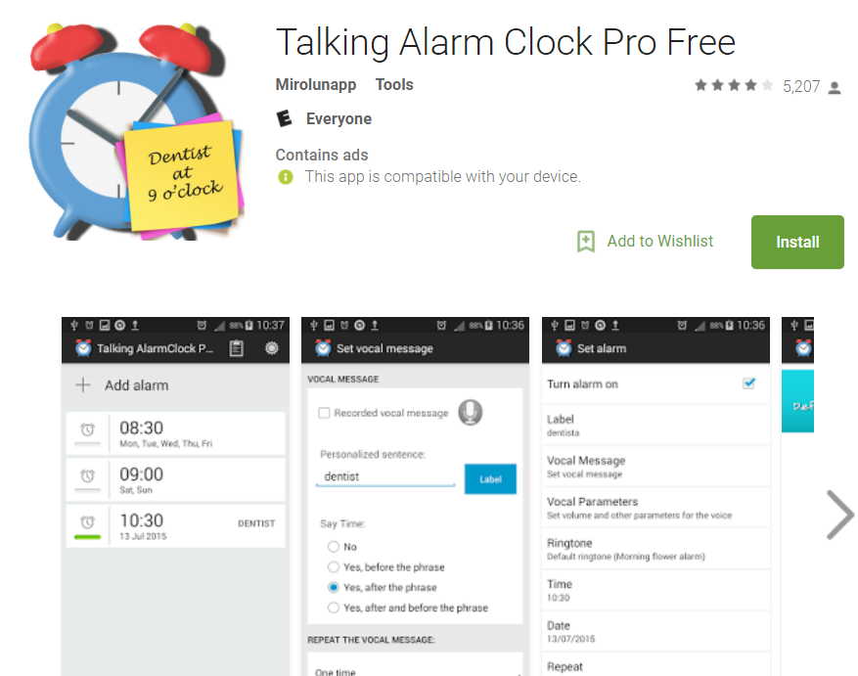
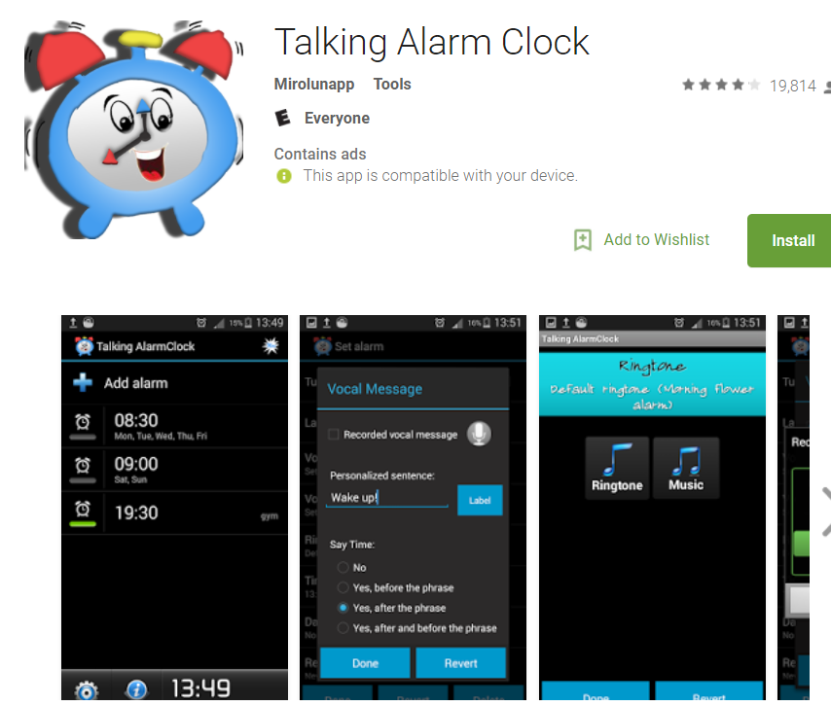
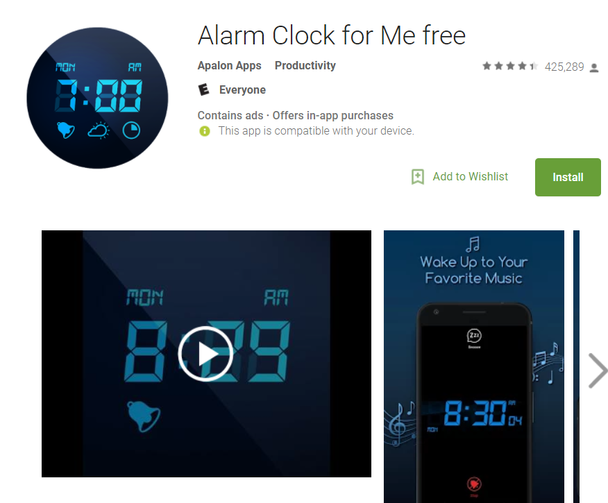
Similar Ideas
v

Slide 4
Features
Wakes you up using the Android Text-to-Speech feature.
Reads out loud the weather from Open Weather Map API, events on your calendar for that day, or plays a standard alarm noise

Slide 5
Progress
GUI Layouts aLL In Place and Logic for everything
SQLite Database setup
Alarm Application plays noise during alarms
Text To Speech Audible

Slide 6
Unfinished Work
Apply Selection of Alarm Functionality / IE: Soundcloud Launcher, Music Selection

Slide 7
Progress
Choose Repeat Days
Database
Location Based
Weather Alarm
Speech to Text

